Slide 1
CHANCE AND DATA
♦ represent data
Population and Samples
Central Limit Theorem
♦ interpret data
Infer population statistics
confidence interval and level
sample size

Slide 2
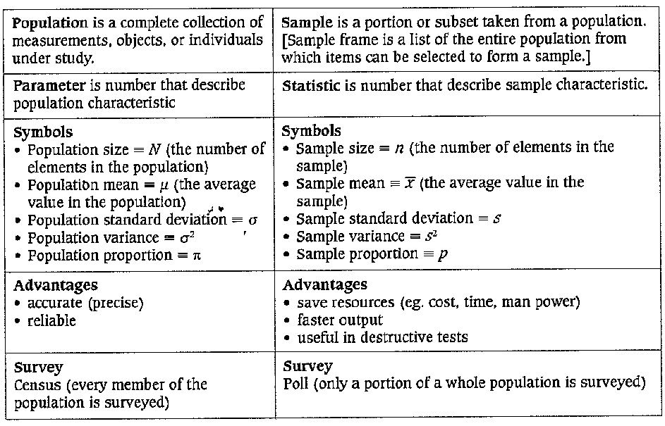
POPULATIONS AND SAMPLES
Random samples are a subset taken from a population where every item/object in a population has an equal chance of being picked or selected

Slide 3
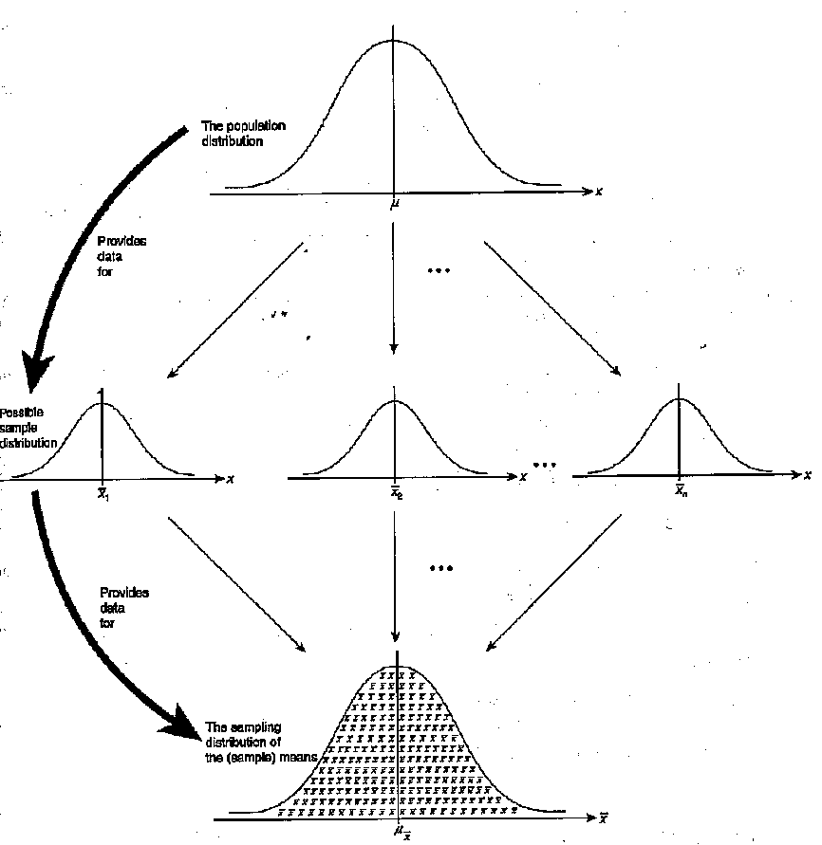
SAMPLING DISTRIBUTIONS
Sampling distribution is the probability distribution of a statistics
Sampling distribution of the sample means the arithmetic means of all the possible random samples of size n that could be selected from a given population

Slide 4
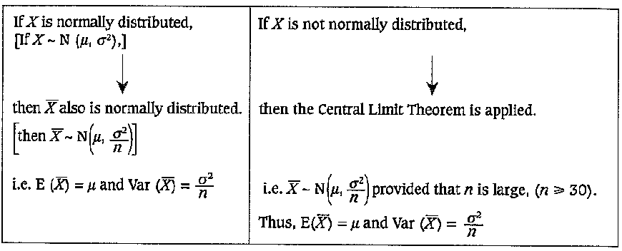
For the sampling distribution of the sample means:
If the population is normally distributed, the sampling distribution is normal regardless of the sample size
If the population is not normally distributed, then the sampling distribution will apply the Central limit theorem

Slide 5
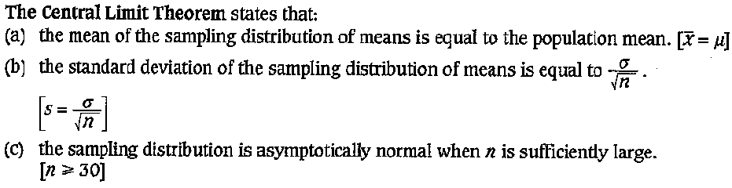

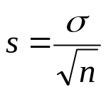
CENTRAL LIMIT THEOREM
The standard deviation of the sampling distribution of sample means the standard error of the mean and is represented by the symbol
Standard error (sampling error) of the mean is the deviation of a sample mean from the mean of the sampling distribution
When n is large, the distribution of sample is approximately normal and the larger the sample size, the better the approximation

Slide 6
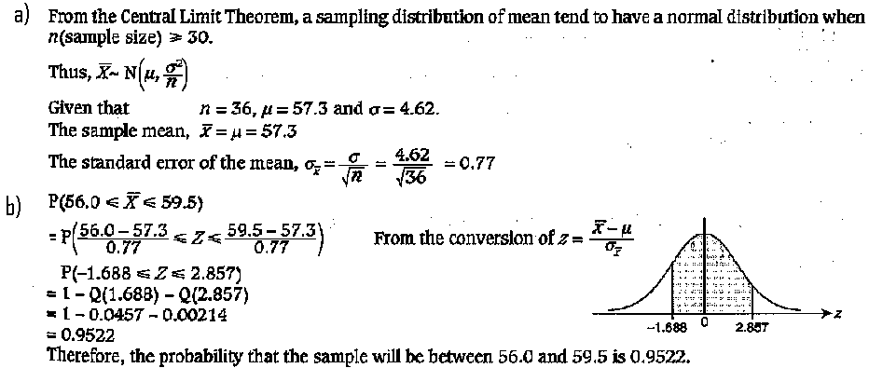
EXAMPLE
A random sample of size 36 is taken from a population with mean
57.3 and standard deviation 4.62. Find:
the sample mean and the standard error of the mean
the probability that the sample will be between 56.0 and 59.5

Slide 7
QUESTION
1) A random sample of size 100 is taken from a population with mean 0.45 and standard deviation 0.03. Find:
the sample mean and the standard error of the mean
the probability that the sample will be between 0.447 and 0.453
[ans: (a) 0.45, 0.003, (b) 0.6826]
2) Given the population of heights of 15000 male students at a college with mean 170cm and standard deviation 40cm. 100 random samples of 30 students are obtained.
Is the sampling distribution normally distributed? Explain.
Calculate the mean and standard error of the mean
Find the probability that the mean of the samples in between 165 and 175cm
How many samples would you expect to find mean in between 165 and 175cm?
[ans: (b) 170, 7.303 (c) 0.5064 (d) 51]

